Slide 1
Electronic Devices
Mid Term Lecture - 01
Faculty Name: Dr. Mohammad Alif Arman
Email : dr.alifarman@aiub.edu
Reference book:
Electronic Devices and Circuit Theory (Chapter-1)
Robert L. Boylestad and L. Nashelsky , (11th Edition)

Slide 2
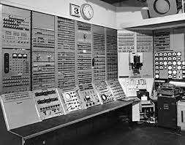


Introduction
The technology advancing so fast and so the fundamental principles. Systems are incredibly smaller, current speeds of operation are truly remarkable, and new gadgets surface every day, leaving us to wonder where technology is taking us.

Slide 3
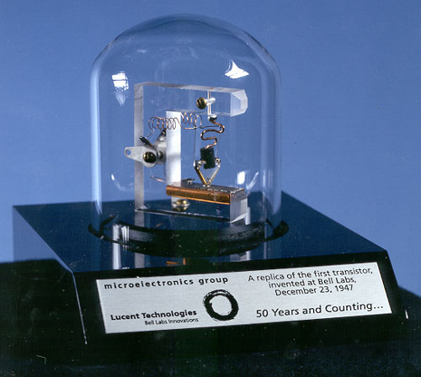
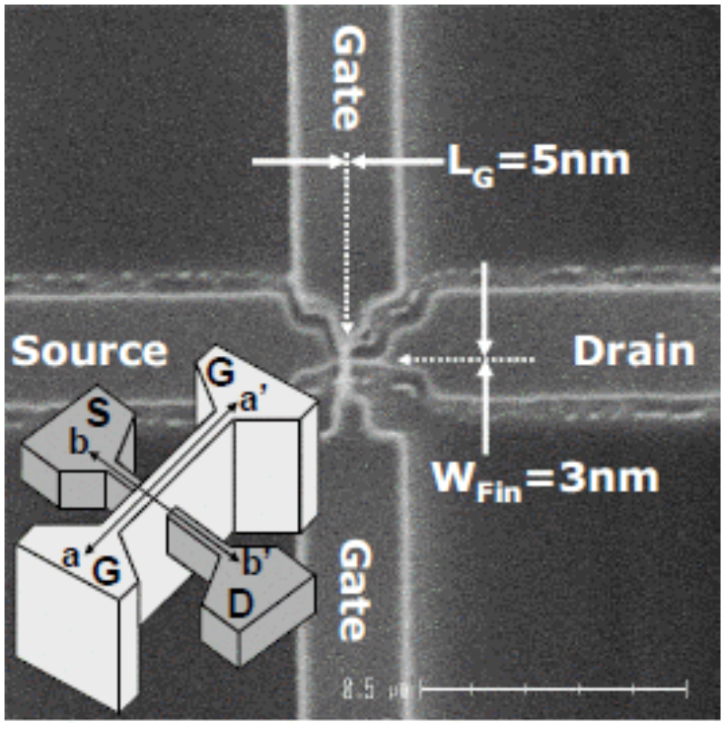
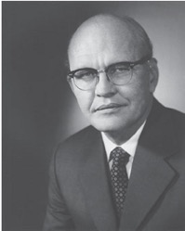
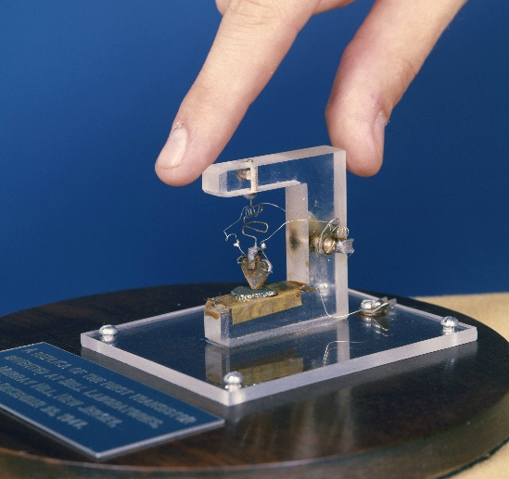
Introduction Contd.
Figure 1.1: Jack St. Clair Kilby, inventor (1958) of the integrated circuit and co-inventor of the electronic handheld calculator. (Texas Instruments.)
Complete systems now appear on wafers thousands of times smaller than the single element of earlier networks.

Slide 4
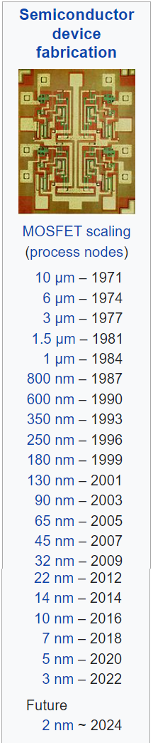


Introduction Contd.
Today, the Intel® CoreTM i7 Extreme Edition Processor of Fig. 1.2 has 731 million transistors in a package that is only slightly larger than a 1.67 sq. inches.
In 1965, Dr. Gordon E. Moore presented a paper predicting that the transistor count in a single IC chip would double every two years.
Now, more than 45 years, later we find that his prediction is amazingly accurate and expected to continue for the next few decades.
Figure 1.2: Intel® Core™ i7 Extreme Edition Processor.

Slide 5
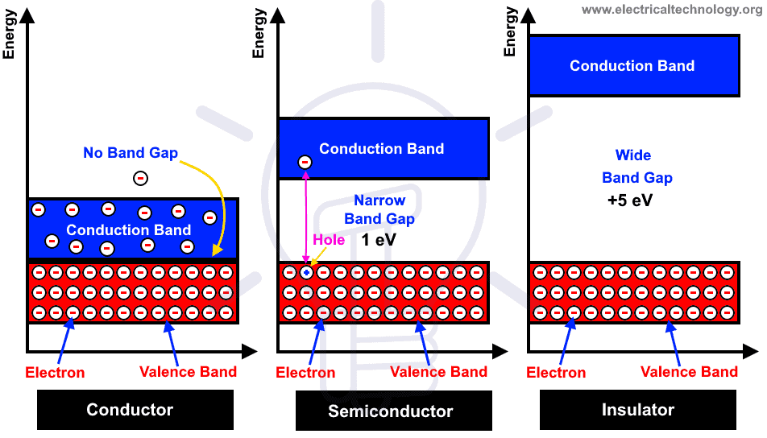
Materials

Slide 6
Why do we use semiconductors instead of conductors in electronics fabrication?
To control.
Transistors need to be able to give us two different outputs to perform logic functions; that is "1" (on) and "0" (off). In short switching ability.

Slide 7
Why do we use semiconductors instead of conductors in electronics fabrication?
Semiconductor materials have a negative temperature coefficient.
Semiconductor materials, however, exhibit an increased level of conductivity with the application of heat. As the temperature rises, an increasing number of valence electrons absorb sufficient thermal energy to break the covalent bond and to contribute to the number of free carriers.
For conductors, the resistance increases with an increase in heat. This is because the numbers of carriers in a conductor do not increase significantly with temperature, but their vibration pattern about a relatively fixed location makes it increasingly difficult for a sustained flow of carriers through the material.
Materials that react in this manner are said to have a positive temperature coefficient.

Slide 8
Semiconductor Materials: Ge, SI & GaAs
The construction of every discrete (individual) solid-state (hard crystal structure) electronic device or integrated circuit begins with a semiconductor material (of the highest quality).
Semiconductors are elements having a conductivity between that of a good conductor and that of an insulator.
In general, semiconductor materials fall into one of two classes: single-crystal and compound.
Single-crystal semiconductors such as germanium (Ge) and silicon (Si) have a repetitive crystal structure, whereas compound semiconductors such as gallium arsenide (GaAs), cadmium sulfide (CdS), gallium nitride (GaN), and gallium arsenide phosphide (GaAsP) are constructed of two or more semiconductor materials of different atomic structures.
Ge, Si, and GaAs semiconductors used most frequently in the construction of electronic devices.
What is single-crystal and compound?

Slide 9
Semiconductor Materials: Ge, SI & GaAs Contd.
Germanium:
In the first few decades following the discovery of the diode in 1939 and the transistor in 1947 germanium was used almost exclusively because it was relatively easy to find and was available in fairly large quantities.
It was also relatively easy to refine to obtain very high levels of purity, an important aspect in the fabrication process.
However, it was discovered in the early years that diodes and transistors constructed using germanium as the base material suffered from low levels of reliability due primarily to its sensitivity to changes in temperature.

Slide 10
Semiconductor Materials: Ge, SI & GaAs Contd.
Silicon:
At the time, scientists were aware that another material, silicon, had improved temperature sensitivities, but the refining process for manufacturing silicon of very high levels of purity was still in the development stages. In 1954 the first silicon transistor was introduced, and silicon quickly became the semiconductor material of choice due to,
Silicon is Less temperature sensitive
one of the most abundant materials on earth, removing any concerns about availability.

Slide 11
Semiconductor Materials: Ge, SI & GaAs Contd.
Gallium Arsenide:
As time moved on, however, the field of electronics became increasingly sensitive to issues of speed.
Scientist developed the first compound material GaAs transistor in the early 1970s.
The speed of operation: up to FIVE times that of Si.
GaAs was more difficult to manufacture at high levels of purity, was more expensive, and had little design support in the early years of development.
However, in time the demand for increased speed resulted in more funding for GaAs research, to the point that today it is often used as the base material for new high-speed, very large scale integrated (VLSI) circuit designs.

Slide 12
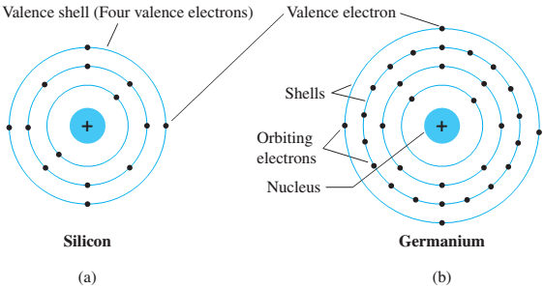
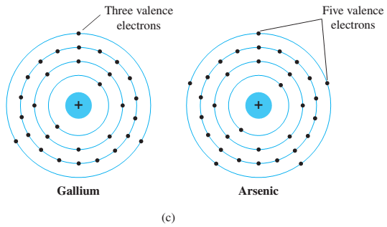
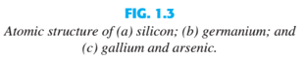
Covalent Bonding and Intrinsic Materials
To fully appreciate why Si, Ge, and GaAs are the semiconductors of choice for the electronics industry requires some understanding of the atomic structure of each and how the atoms are bound together to form a crystalline structure.
The fundamental components of an atom are the electron, proton, and neutron.
In the lattice structure, neutrons and protons form the nucleus and electrons appear in fixed orbits around the nucleus. The Bohr model for the three materials is provided in Fig. 1.3.

Slide 13
Covalent Bonding & Intrinsic Materials Contd.
As indicated in Fig. 1.3, silicon has 14 orbiting electrons, germanium has 32 electrons, gallium has 31 electrons, and arsenic has 33 orbiting electrons (the same arsenic that is a very poisonous chemical agent).
For germanium and silicon there are four electrons in the outermost shell, which are referred to as valence electrons.
Gallium has three valence electrons and arsenic has five valence electrons.
Atoms that have four valence electrons are called tetravalent, those with three are called trivalent, and those with five are called pentavalent.
The term valence is used to indicate that the potential (ionization potential) required to remove any one of these electrons from the atomic structure is significantly lower than that required for any other electron in the structure.

Slide 14
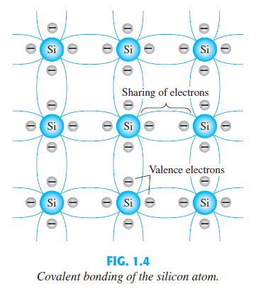
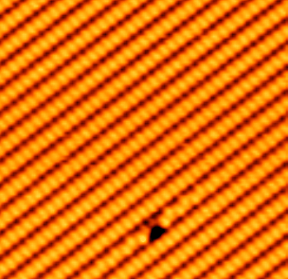
Covalent Bonding & Intrinsic Materials Contd.
In a pure silicon or germanium crystal the four valence electrons of one atom form a bonding arrangement with four adjoining atoms, as shown in Fig. 1.4.
This bonding by the sharing of electrons, is called covalent bonding.

Slide 15
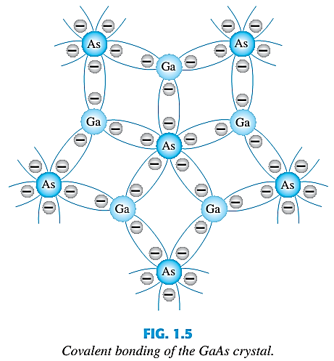
Covalent Bonding & Intrinsic Materials Contd.
Because GaAs is a compound semiconductor, there is sharing between the two different atoms, as shown in Fig. 1.5.
Each atom, gallium or arsenic, is surrounded by atoms of the complementary type. Here five electrons are provided by the As atom and three by the Ga atom.

Slide 16
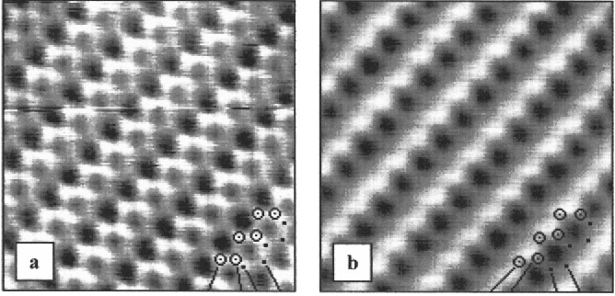
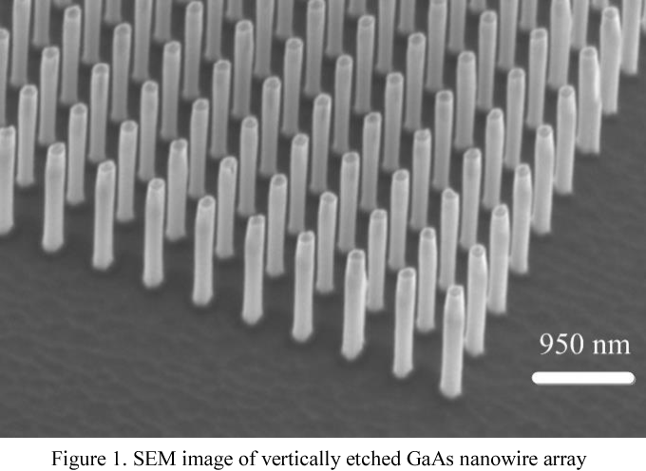
Semiconductor Materials: Ge, SI & GaAs Contd.
Gallium Arsenide:
c

Slide 17
Covalent Bonding & Intrinsic Materials Contd.
Although the covalent bond will result in a stronger bond between the valence electrons and their parent atom, it is still possible for the valence electrons to absorb sufficient kinetic energy from external natural causes to break the covalent bond and assume the “free” state.
The term free is applied to any electron that has separated from the fixed lattice structure and is very sensitive to any applied electric fields such as established by voltage sources or any difference in potential.
The external causes include effects such as light energy in the form of photons and thermal energy (heat) from the surrounding medium.
At room temperature there are approximately 1.5 * 10¹⁰ free carriers in 1 cm³ of intrinsic silicon material, that is, 15,000,000,000 (15 billion) electrons in a space smaller than a small sugar cube - an enormous number.
What is FREE Electron?

Slide 18
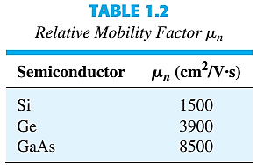
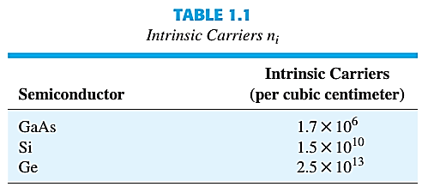
Covalent Bonding & Intrinsic Materials Contd.
The term intrinsic is applied to any semiconductor material that has been carefully refined to reduce the number of impurities to a very low level-essentially as pure as can be made available through modern technology.
The free electrons in a material due only to external causes are referred to as intrinsic carriers. Table1.1 compares the number of intrinsic carriers per cubic centimeter(abbreviated n_{i}) for Ge, Si, and GaAs.

Slide 19
Covalent Bonding & Intrinsic Materials Contd.
It is interesting to note that Ge has the highest number of free electron and GaAs the lowest.
In fact, Ge has more than twice the number as GaAs.
The number of carriers in the intrinsic form is important, but other characteristics of the material are more significant in determining its use in the field.
One such factor is the relative mobility (µ_{n}) of the free carriers in the material, that is, the ability of the free carriers to move throughout the material.
Table 1.2 clearly reveals that the free carriers in GaAs have more than five times the mobility of free carriers in Si, a factor that results in response times using GaAs electronic devices that can be up to five times those of the same devices made from Si.
Note also that free carriers in Ge have more than twice the mobility of electrons in Si, a factor that results in the continued use of Ge in high-speed radio frequency applications.

Slide 20
Covalent Bonding & Intrinsic Materials Contd.
Extremely high levels of purity are necessary because the addition of one part of impurity (of the proper type) per million in a wafer of silicon material can change that material from a relatively poor conductor to a good conductor of electricity.
The ability to change the characteristics of a material through this process is called doping, something that germanium, silicon, and gallium arsenide readily and easily accept.
One important and interesting difference between semiconductors and conductors is their reaction to the application of heat.

Slide 21
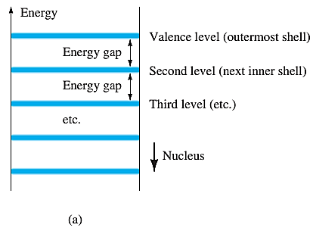
Energy Levels
Within the atomic structure of each and every isolated atom there are specific energy levels associated with each shell and orbiting electron, as shown in Fig. 1.6.
The energy levels associated with each shell will be different for every element.
The farther an electron is from the nucleus, the higher is the energy state, and any electron that has left its parent atom has a higher energy state than any electron in the atomic structure.

Slide 22
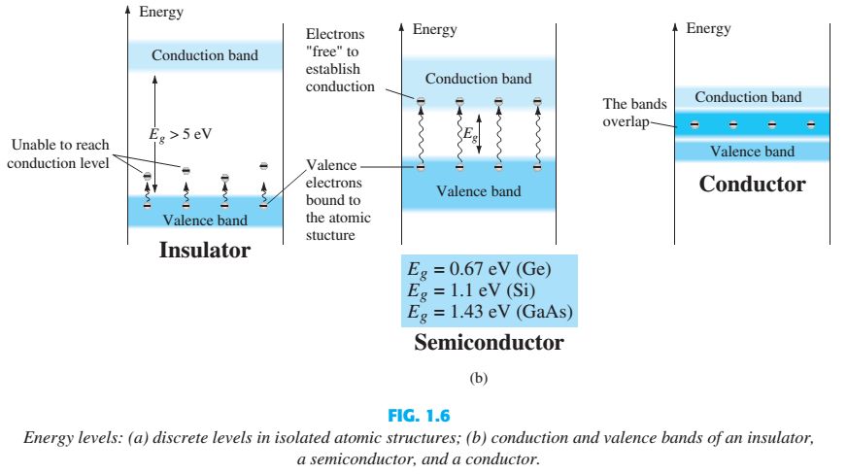
Energy Levels Contd.

Slide 23
n-Type & p-Type Materials
The characteristics of a semiconductor material can be altered significantly by the addition of specific impurity atoms to the relatively pure semiconductor material.
These impurities, although only added at 1 part in 10 million, can alter the band structure sufficiently to totally change the electrical properties of the material.
A semiconductor material that has been subjected to the doping process is called an extrinsic material.
There are two extrinsic materials of massive importance to semiconductor device fabrication: n -type and p -type materials.

Slide 24
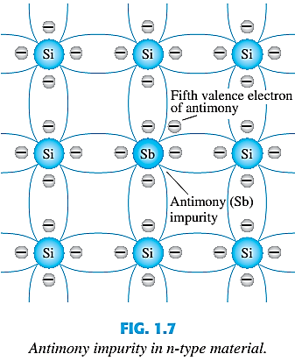
n-Type Material
An n -type material is created by introducing impurity elements that have five valence electrons (pentavalent), such as antimony, arsenic, and phosphorus. (Group V elements in Periodic Table)
The effect of such impurity elements is indicated in Fig. 1.7 (using antimony as the impurity in a silicon base).

Slide 25
n-Type Material Contd.
Note that the four covalent bonds are still present. There is, however, an additional fifth electron due to the impurity atom, which is unassociated with any particular covalent bond.
This remaining electron, loosely bound to its parent (antimony) atom, is relatively free to move within the newly formed n -type material.
Diffused impurities with five valence electrons are called donor atoms.
It is important to realize that even though a large number of free carriers have been established in the n -type material, it is still electrically Positive or negative?
neutral since ideally the number of positively charged protons in the nuclei is still equal to the number of free and orbiting negatively charged electrons in the structure.

Slide 26
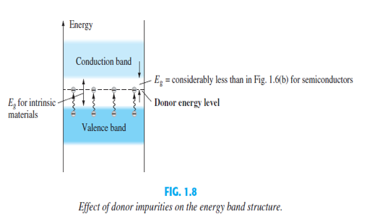
n-Type Material Contd.
Those free electrons due to the added impurity sit at this energy level and have less difficulty absorbing a sufficient measure of thermal energy to move into the conduction band at room temperature.
Conductivity of the material will increase or decrease?
The result is that at room temperature, there are a large number of carriers (electrons) in the conduction level, and the conductivity of the material increases significantly.
In which application this process is crucial?
Photo electric effect – Solar cell

Slide 27
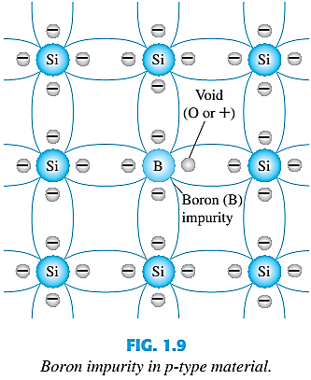
p-Type Material
The p -type material is formed by doping a pure germanium or silicon crystal with impurity atoms having three valence electrons.
The elements most frequently used for this purpose are boron, gallium, and indium. (Group III elements in Periodic Table)
Note that there is now an insufficient number of electrons to complete the covalent bonds of the newly formed lattice.

Slide 28
p-Type Material Contd.
The resulting vacancy is called a hole and is represented by a small circle or a plus sign, indicating the absence of a negative charge.
Since the resulting vacancy will readily accept a free electron:
The added impurities with three valence electrons are called acceptor atoms.
The resulting p -type material is electrically - +?
neutral, for the same reasons described for the n -type material.

Slide 29
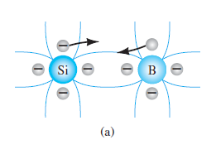
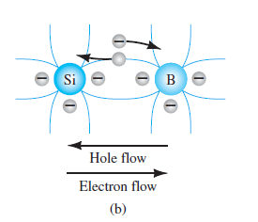
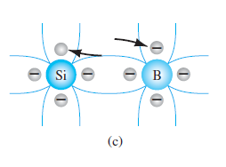
Electron vs Hole Flow
The effect of the hole on conduction is shown in Fig. If a valence electron acquires sufficient kinetic energy to break its covalent bond and fills the void created by a hole, then a vacancy, or hole, will be created in the covalent bond that released the electron.

Slide 30
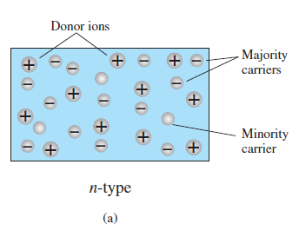
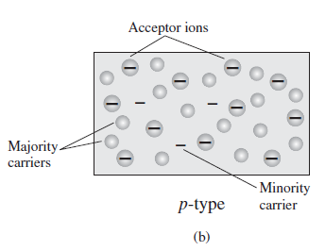
Majority & Minority Carriers
In an n-type material ( Fig. a ) the electron is called the majority carrier and the hole the minority carrier.
In a p-type material the hole is the majority carrier and the electron is the minority carrier.

Slide 31
Outcome
Knowledge
Basic of semiconductor
Doping principles
Crystal Structure
Importance and principles of Semiconductor
Control electronics
Semiconductor materials have a negative temperature coefficient.
Practical applications
Logic Circuit
CPU
Diode
Solar cell

Slide 32
Electronic Devices
Mid Term Lecture - 02
Faculty Name: Dr. Mohammad Alif Arman
Email : dr.alifarman@aiub.edu
Room: DN0526
Reference book:
Electronic Devices and Circuit Theory (Chapter-1)
Robert L. Boylestad and L. Nashelsky , (11th Edition)

Slide 33
Objectives
Develop a clear understanding of the basic operation and characteristics of a diode in the no-bias, forward-bias, and reverse-bias regions.
Be able to calculate the dc, ac, and average ac resistance of a diode from the characteristics.
Understand the impact of an equivalent circuit whether it is ideal or practical.
Become familiar with the operation and characteristics of a Zener diode and light- emitting diode.

Slide 34
Semiconductor Diode: No Applied Bias (V=0 V)
Now that both n – and p -type materials are available, we can construct our first solid-state electronic device: The semiconductor diode, with applications too numerous to mention, is created by simply joining an n -type and a p -type material together.
In the absence of an applied bias across a semiconductor diode, the net flow of charge in one direction is zero.

Slide 35
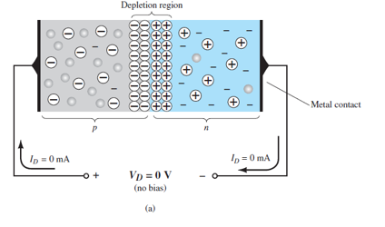
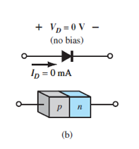
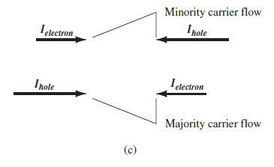
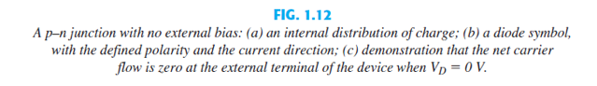
No Applied Bias (VD=0 V)

Slide 36
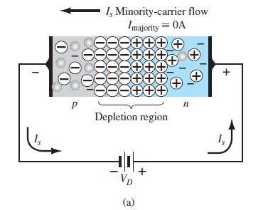
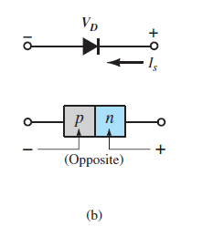
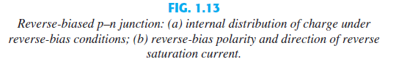
Reverse-Bias Condition (VD<0 V)
The current that exists under reverse-bias conditions is called the reverse saturation current and is represented by I_{s} .

Slide 37
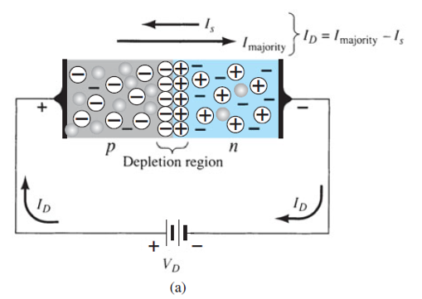
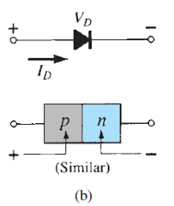
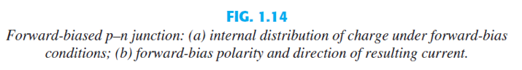
Forward-Bias Condition (VD>0 V)
A forward-bias or “on” condition is established by applying the positive potential to the p -type material and the negative potential to the n -type material as shown in Fig. 1.14 .

Slide 38
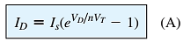
Forward-Bias Condition (VD>0 V) Contd.
It can be demonstrated through the use of solid-state physics that the general characteristics of a semiconductor diode can be defined by the following equation, referred to as Shockley’s equation, for the forward- and reverse-bias regions:
Where, I_{s} is the reverse saturation current
V_{D} is the applied forward-bias voltage across the diode
n is an ideality factor, which is a function of the operating conditions and physical construction; it has a range between 1 and 2 depending on a wide variety of factors (n = 1 will be assumed throughout this text unless otherwise noted).

Slide 39
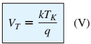
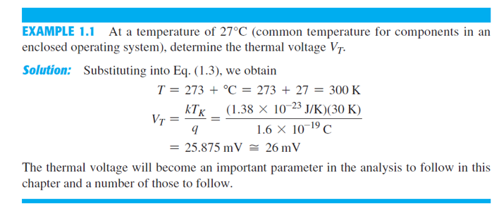
Forward-Bias Condition (VD>0 V) Contd.
The voltage V_{T} in Eq. (1.1) is called the thermal voltage and is determined by:
where k is Boltzmann’s constant = 1.38 * 10⁻²³ J/K
T_{K} is the absolute temperature in kelvins = 273 + the temperature in °C
q is the magnitude of electronic charge = 1.6 * 10⁻¹⁹ C

Slide 40
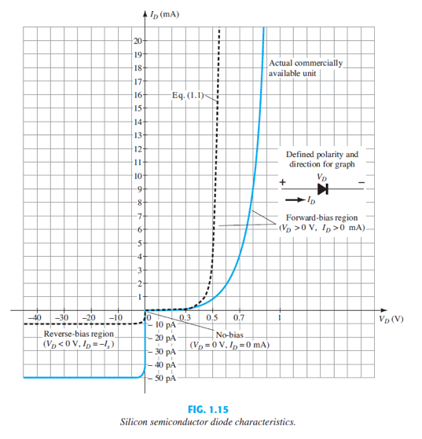
Semiconductor Diode Characteristics

Slide 41
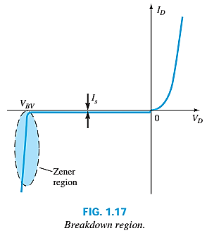
Breakdown Region
The maximum reverse-bias potential that can be applied before entering the breakdown region is called the peak inverse voltage (referred to simply as the PIV rating) or the peak reverse voltage (denoted the PRV rating).
If an application requires a PIV rating greater than that of a single unit, a number of diodes of the same characteristics can be connected in series. Diodes are also connected in parallel to increase the current-carrying capacity.
In general, the breakdown voltage of GaAs diodes is about 10% higher those for silicon diodes but after 200% higher than levels for Ge diodes.

Slide 42
Breakdown Region Contd.
As the voltage across the diode increases in the reverse-bias region, the velocity of the minority carriers responsible for the reverse saturation current Is?
Eventually, their velocity and associated kinetic energy (W_{K} = 1/2 mv²) will be sufficient to release additional carriers through collisions with otherwise stable atomic structures.
An ionization process will result whereby valence electrons absorb sufficient energy to leave the parent atom.
These additional carriers can then aid the ionization process to the point where a high avalanche current is established and the avalanche breakdown region determined.
will also increase.

Slide 43
Breakdown Region Contd.
The avalanche region (V_{BV}) can be brought closer to the vertical axis by increasing the doping levels in the p- and n-type materials.
However, as V_{BV} decreases to very low levels, such as -5 V, another mechanism, called Zener breakdown, will contribute to the sharp change in the characteristic.
It occurs because there is a strong electric field in the region of the junction that can disrupt the bonding forces within the atom and “generate” carriers.
Although the Zener breakdown mechanism is a significant contributor only at lower levels of V_{BV}, this sharp change in the characteristic at any level is called the Zener region, and diodes employing this unique portion of the characteristic of a p–n junction are called Zener diodes.

Slide 44
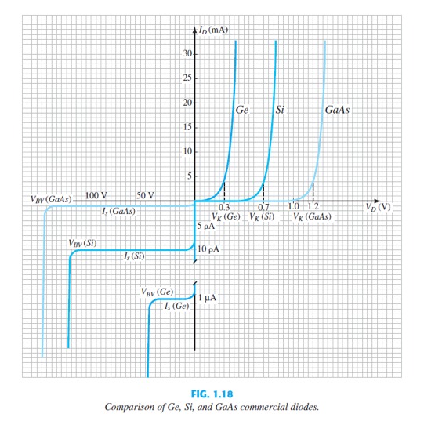
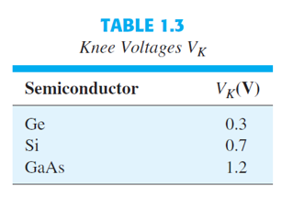
Ge, Si & GaAs
Knee voltage is the forward voltage at which the flow of the current through the PN junction of the diode increases rapidly.

Slide 45
Temperature Effects
In the forward-bias region the characteristics of a silicon diode shift to the left at a rate of 2.5 mV per centigrade degree increase in temperature.
In the reverse-bias region the reverse current of a silicon diode doubles for every 10°C rise in temperature.
The reverse breakdown voltage of a semiconductor diode will increase or decrease with temperature.
As temperature increases it adds energy to the diode:
It reduces the required forward bias voltage for forward bias conduction.
It increases the amount of reverse current in the reverse bias condition.
It increases maximum reverse bias avalanche voltage.
Germanium diodes are more sensitive to temperature variations than silicon or gallium arsenide diodes.

Slide 46
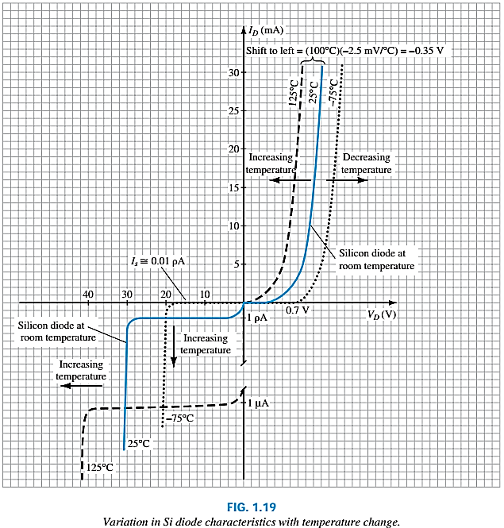
Temperature Effect Contd.
In the forward-bias region the characteristics of a silicon diode shift to the left at a rate of 2.5 mV per centigrade degree increase in temperature.
In the reverse-bias region the reverse current of a silicon diode doubles for every 10°C rise in temperature.
Finally, The reverse breakdown voltage of a semiconductor diode will increase or decrease with temperature.

Slide 47
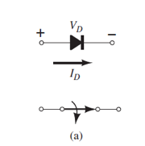
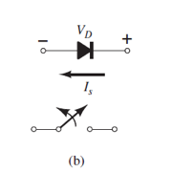
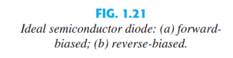
Ideal vs Practical
The semiconductor diode behaves in a manner similar to a mechanical switch in that it can control whether current will flow between its two terminals.
The semiconductor diode is different from a mechanical switch in the sense that when the switch is closed it will only permit current to flow in one direction.

Slide 48
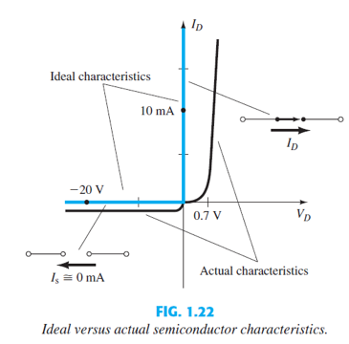
Ideal vs Practical Contd.
Ideally, if the semiconductor diode is to behave like a closed switch in the forward-bias region, the resistance of the diode should be 0 Ω.
In the reverse-bias region its resistance should be ∞ Ω to represent the open-circuit equivalent.

Slide 49
Resistance Levels
Semiconductors react differently to DC and AC currents.
There are three types of resistance:
DC (static) resistance
AC (dynamic) resistance
Average AC resistance

Slide 50
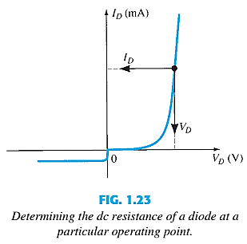

DC or Static Resistance
For a specific applied DC voltage V_{D,} the diode has a specific current I_{D}, and a specific resistance R_{D}.
In general, therefore, the higher the current through a diode, the lower is the dc resistance level.
I
R

Slide 51




Slide 52


AC or Dynamic Resistance
The dc resistance of a diode is independent of the shape of the characteristic in the region surrounding the point of interest.
The designation Q-point is derived from the word quiescent, which means “still or unvarying.”
In general, therefore, the lower the Q-point of operation (smaller current or lower voltage), the higher is the ac resistance.
See Example 1.4.

Slide 53


AC or Dynamic Resistance Contd.
In the forward bias region:
The resistance depends on the amount of current (I_{D}) in the diode.
The voltage across the diode is fairly constant (26 mV for 25°C).
r_{B} ranges from a typical 0.1 Ω for high power devices to 2 Ω for low power, general purpose diodes. In some cases r_{B} can be ignored.
In the reverse bias region:
The resistance is effectively infinite. The diode acts like an open.

Slide 54


Average AC or Resistance
The average ac resistance is, by definition, the resistance determined by a straight line drawn between the two intersections established by the maximum and minimum values of input voltage.

Slide 55
Average AC or Resistance
Vmin = 0.65v Imin = 2mA
Vmax = 0.725v Imax = 17mA
Vd = 0.725 – 0.65 = 0.075V
Id = 17 – 2 = 15mA
Rav = 0.075/15 = 5ohm
Rd Vd = 0.65 > 5 ohm
Rd Vd = 0.725 < 5 ohm

Slide 56

Summary table

Slide 57

Diode Equivalent Circuits
An equivalent circuit is a combination of elements properly chosen to best represent the actual terminal characteristics of a device or system in a particular operating region.

Slide 58
Thank You

Slide 59
Outcome
Knowledge
Basic of PN Junction
Forward, reverse bias and zero bias voltage
Resistance
Principles of Semiconductor growth mechanism
Practical applications
Circuit
Working principle of Diode
Diodes can perform switching and digital logic operations.

Slide 60
Electronic Devices
Mid Term Lecture - 03
Faculty Name: Dr. Mohammad Alif Arman
Email : dr.alifarman@aiub.edu
Room: DN0526
Reference book:
Electronic Devices and Circuit Theory (Chapter-2)
Robert L. Boylestad and L. Nashelsky , (11th Edition)

Slide 61
Objectives
Understand the concept of load-line analysis and how it is applied to diode networks.
Become familiar with the use of equivalent circuits to analyze series, parallel, and series-parallel diode networks.

Slide 62

LOAD-LINE ANALYSIS
A load line is a line drawn on the IV characteristics curve.
The load line plots all possible combinations of diode current (I_{D}) and voltage (V_{D}) for a given circuit.
The maximum I_{D} equals E/R, and the maximum V_{D} equals E.
The point where the load line and the characteristic curve intersect is the Q-point, which identifies I_{D} and V_{D} for a particular diode in a given circuit.

Slide 63




LOAD-LINE ANALYSIS

Slide 64






LOAD-LINE ANALYSIS

Slide 65




LOAD-LINE ANALYSIS

Slide 66

SERIES DIODE CONFIGURATIONS

Slide 67


SERIES DIODE CONFIGURATIONS
Replace with equivalent Circuit

Slide 68



SERIES DIODE CONFIGURATIONS
Replace with equivalent Circuit

Slide 69




SERIES DIODE CONFIGURATIONS

Slide 70




SERIES DIODE CONFIGURATIONS

Slide 71



SERIES DIODE CONFIGURATIONS

Slide 72




SERIES DIODE CONFIGURATIONS

Slide 73





SERIES DIODE CONFIGURATIONS
Applying KVL,

Slide 74





SERIES-PARALLEL CONFIGURATIONS
See Example 2.11

Slide 75



SERIES-PARALLEL CONFIGURATIONS

Slide 76





SERIES-PARALLEL CONFIGURATIONS
See Example 2.14 and 2.15

Slide 77
Thank You

Slide 78
Electronic Devices
Mid Term Lecture - 04
Faculty Name: Dr. Mohammad Alif Arman
Email : dr.alifarman@aiub.edu
Room: DN0526
Reference book:
Electronic Devices and Circuit Theory (Chapter-2)
Robert L. Boylestad and L. Nashelsky , (11th Edition)

Slide 79
Objectives
Understand the process of rectification to establish a dc level from a sinusoidal ac input.

Slide 80





SINUSOIDAL INPUTS; HALF-WAVE

Slide 81



HALF-WAVE RECTIFICATION
The process of removing one-half the input signal to establish a dc level is called halfwave rectification.
The effect of using a silicon diode with V_{K} = 0.7 V is demonstrated in below Figure for the forward-bias region. The applied signal must now be at least 0.7 V before the diode can turn “on.”

Slide 82



HALF-WAVE RECTIFICATION

Slide 83


HALF-WAVE RECTIFICATION

Slide 84


PIV (PRV)
It is the voltage rating that must not be exceeded in the reverse-bias region or the diode will enter the Zener avalanche region.
Applying Kirchhoff’s voltage law, it is fairly obvious that the PIV rating of the diode must equal or exceed the peak value of the applied voltage.

Slide 85



FULL-WAVE RECTIFICATION: BRIDGE NETWORK

Slide 86


BRIDGE NETWORK

Slide 87




BRIDGE NETWORK

Slide 88



CENTER-TAPPED TRANSFORMER
Network conditions for the positive region of v_{i}

Slide 89




CENTER-TAPPED TRANSFORMER
Network conditions for the negative region of v_{i}

Slide 90





Slide 91
Thank You

Slide 92
Electronic Devices
Mid Term Lecture - 05
Faculty Name: Dr. Mohammad Alif Arman
Email : dr.alifarman@aiub.edu
Room: DN0526
Reference book:
Electronic Devices and Circuit Theory (Chapter-2)
Robert L. Boylestad and L. Nashelsky , (11th Edition)

Slide 93
Objectives
Be able to predict the output response of a clipper and clamper diode configuration.

Slide 94
CLIPPERS
Clippers are networks that employ diodes to “clip” away a portion of an input signal without distorting the remaining part of the applied waveform.
The half-wave rectifier is an example of the simplest form of diode clipper- one resistor and a diode. Depending on the orientation of the diode, the positive or negative region of the applied signal is “clipped” off.
There are two general categories of clippers: series and parallel.
The series configuration is defined as one where the diode is in series with the load, whereas the parallel variety has the diode in a branch parallel to the load.

Slide 95



CLIPPERS: SERIES
Diode is in series with the load.

Slide 96


Series Clipper with a dc supply

Slide 97


CLIPPERS: SERIES
Use transition voltage to define “on” and “off” regions
Draw the output waveform directly below the applied voltage using the same scales for the horizontal axis and the vertical axis.
Negative half cycle clipped away in output waveform

Slide 98






CLIPPERS: SERIES
Determine transition level

Slide 99



CLIPPERS: SERIES
For v_{i} = 20 V (0 --> T/2) the network results,
The diode is in the short-circuit state.
v_{o} = 20V + 5V = 25V

Slide 100


For v_{i} = -10 V (T/2 --> T) the network results,
The diode is in the “off” state.
v_{o} = i_{R}R = (0)R = 0 V
The resulting output voltage corresponds to input voltage appears as:

Slide 101



CLIPPERS: PARALLEL
Diode in a branch parallel to the load.

Slide 102



CLIPPERS: PARALLEL
Determine output across the series combination of the diode and the 4-V supply
Determine transition level of input voltage.
Condition:
Replace circuit with short-circuit equivalent.
Diode current is 0 mA.

Slide 103




For $v_{i}≥4V$, diode is on.
$$v_{o}=4V$$
For $v_{i}<4V$, diode is off.
$$v_{o}=v_{i}$$

Slide 104


CLIPPERS: PARALLEL
Si
Determine transition level of input voltage.
Condition:
Replace circuit with diode equivalent circuit.
Diode current is 0 mA.
Applying KVL around output loop in clockwise direction,

Slide 105





For $v_{i}>3.3V$, I_{D} direction is counter-clockwise.
Diode is off.
$$v_{o}=v_{i}$$
For $v_{i}≤3.3V$, I_{D} direction is counter-clockwise
Diode is on.
$$v_{o}=4 V −0.7 V=3.3 V$$

Slide 106






CLIPPERS
Simple Series clippers (Ideal Diodes) for the sinusoidal input
Biased Series Clippers (Ideal Diodes)

Slide 107







CLIPPERS
Simple Parallel clippers (Ideal Diodes) for the sinusoidal input
Biased Parallel Clippers (Ideal Diodes)

Slide 108


CLAMPERS
A clamper is a network constructed of a diode, a resistor, and a capacitor that shifts a waveform to a different dc level without changing the appearance of the applied signal.
The output signal is clamped to 0 V for the interval 0 to T/2 but maintains the same total swing (2V ) as the input.

Slide 109




CLAMPERS
Step 1: Start the analysis by examining the response of the portion of the input signal that will forward bias the diode.
Step 2: During the period that the diode is in the “on” state, assume that the capacitor will charge up instantaneously to a voltage level determined by the surrounding network.
Step 3: Assume that during the period when the diode is in the “off” state the capacitor holds on to its established voltage level.
For the interval 0 -> T/2 :
For the interval T/2 -> T :
$$v_{o}=0$$
$$v_{c}=V$$

Slide 110

Step 4: Throughout the analysis, maintain a continual awareness of the location and defined polarity for v_{o} to ensure that the proper levels are obtained.
Step 5: Check that the total swing of the output matches that of the input.
The output signal maintains the same total swing (2V) as the input.

Slide 111




CLAMPERS
From t₁ to t₂ period of the input signal the diode will be forward biased.
$$v_{o}=5 V$$

Slide 112




From t₂ to t₃ period of the input signal the diode will be reverse biased
The output swing of 30 V matches the input swing.
See Example 2.23

Slide 113






Clamping Networks

Slide 114
Thank You

Slide 115
Electronic Devices
Mid Term Lecture - 06
Faculty Name: Dr. Mohammad Alif Arman
Email : dr.alifarman@aiub.edu
Room: DN0526
Reference book:
Electronic Devices and Circuit Theory (Chapter-2)
Robert L. Boylestad and L. Nashelsky , (11th Edition)

Slide 116
Objectives
Become familiar with the analysis of and the range of applications for Zener diodes.

Slide 117

ZENER REGION
If the Diode is reverse biased and the voltage is increased, a point will be reached when the diode enters reverse breakdown and current will flow with a very rapid rate.
The direction of this current will be opposite to that of the positive voltage region.
The reverse bias potential that results in this dramatic change in characteristics is called the Zener Potential /Voltage and is given by the symbol V_{z}.
The reverse or Avalanche breakdown is often termed as Zener Breakdown (at very low levels).
The region where this sharp change in characteristics occur is known as Zener or Avalanche breakdown region and the current is termed as avalanche current.

Slide 118

ZENER REGION
The maximum reverse-bias potential that can be applied before entering the Zener Region is called the peak inverse voltage (referred to simply as the PIV rating) or the peak reverse voltage (denoted by PRV rating).

Slide 119

ZENER DIODE
Diodes that employ the dramatic characteristics of a p-n junction are called Zener Diodes.
Therefore, a Zener diode operates in reverse bias.
Common Zener Voltages: 1.8V to 200V.

Slide 120


ZENER DIODE
The state of the diode must be determined followed by a substitution of the appropriate model and a determination of the unknown quantities of the network.
The off state is defined by a voltage less than V_{z} but greater than 0V. The Zener equivalent is the open circuit.

Slide 121

ZENER DIODE
The Zener diode is a heavily doped diode which, as a result of doping, has a very narrow depletion region. This allows the diode to be operated in the reverse biased region of the characteristic curve without damaging the PN junction.
“Zener Effect”: The area of Zener diode operation (<5V) where the Diode maintains a constant voltage output while operating reverse biased.
“Avalanche Effect”: >5V applied to the diode while reverse biased which tends to cause the diode to eventually breakdown due to heat generation within the lattice structure of the crystal.

Slide 122
ZENER DIODE
Because of its higher temperature and current capability, silicon is usually preferred in manufacture of Zener Diodes.
Zener Diodes provide a stable reference voltage for use in power supplies, voltmeter & other instruments, voltage regulators.

Slide 123


ZENER DIODE EXAMPLE

Slide 124



ZENER DIODE EXAMPLE

Slide 125



1st CONDITION: V_{i} AND R FIXED
The simplest of Zener diode regulator networks appears in Fig. 2.112 . The applied dc voltage is fixed, as is the load resistor. The analysis can fundamentally be broken down into two steps.
1. Determine the state of the Zener diode by removing it from the network and calculating the voltage across the resulting open circuit.
If V ≥ V_{Z}, the Zener diode is on, and the appropriate equivalent model can be substituted.
If V < V_{Z}, the diode is off, and the open-circuit equivalence is substituted.

Slide 126





1st CONDITION: V_{i} AND R FIXED
2. Substitute the appropriate equivalent circuit and solve for the desired unknowns.
For the network of Fig. 2.112 , the “on” state will result in the equivalent network of Fig.2.114 . Since voltages across parallel elements must be the same, we find that
The power dissipated by the Zener diode is determined by
That must be less than the P_{ZM} specified for the device.

Slide 127




1st CONDITION: V_{i} AND R FIXED

Slide 128



1st CONDITION: V_{i} AND R FIXED

Slide 129



1st CONDITION: V_{i} AND R FIXED

Slide 130



2nd CONDITION: FIXED V_{i}, VARIABLE R_{L}
Due to the offset voltage V_{z}, there is a specific range of resistor values (and therefore load current) which will ensure that the Zener diode is in the on state.
Too small R_{L} → V_{L} < V_{z} → Zener diode will be in the off state.
To determine the min R_{L} that will turn the Zener diode on :
Any load resistance value greater than the R_{L} min will ensure that the Zener diode is in the on state and the diode can be replaced by its V_{z} source equivalent.
The max I_{L}

Slide 131





2nd CONDITION: FIXED V_{i}, VARIABLE R_{L}
Once the diode is in the on state, the voltage across R remains fixed at:
I_{z} is limited to I_{ZM} as provided on the data sheet, it does affect the range of R_{L} and therefore I_{L}.
The maximum load resistance
See Example 2.27.

Slide 132





3rd CONDITION: FIXED R_{L}, VARIABLE V_{i}
For fixed values of R_{L}, the voltage V_{i} must be sufficiently large to turn the Zener diode on. The min turn-on voltage V_{i}=V_{i min} :
The max value of V_{i} is limited by the max Zener current I_{ZM}.
Since I_{L} is fixed at V_{Z}/R_{L} and I_{ZM} is the max value of I_{Z}, the max V_{i} is defined by:

Slide 133


3rd CONDITION: FIXED R_{L}, VARIABLE V_{i}

Slide 134
Thank You

Slide 135
Electronic Devices
Mid Term Lecture - 07
Faculty Name: Dr. Mohammad Alif Arman
Email : dr.alifarman@aiub.edu
Room: DN0526
Reference book:
Electronic Devices and Circuit Theory (Chapter-3)
Robert L. Boylestad and L. Nashelsky , (11th Edition)

Slide 136
P
N
P
Emitter
Collector
Base
The term bipolar indicates that, both electrons and holes contributes to the flow of current.
Three doped regions. The Emitter, the Base and the Collector.
Based on the doping of these three regions, it is known as either NPN or PNP transistor.
There are two PN junctions.

Slide 137
HOLES
ELECTORNS
P
N
P
Emitter
Collector
Base

Slide 138
P
N
P
Emitter
Collector
Emitter Heavily Doped
Base Lightly Doped and Very Thin
Collector Moderately Doped
Base
C
In case of the NPN transistor, the current will flow from the Base towards the Emitter.
PNP transistor, then the current will flow from the Emitter towards the Base region.
N
P
N
B
E
C
P
N
P
B
E

Slide 139

TRANSISTOR OPERATION
The basic operation will be described using the p-n-p transistor.
The operation of the n-p-n transistor is exactly the same if the roles played by the electron and hole are interchanged.
One p-n junction of a transistor is reverse-biased, whereas the other is forward-biased.

Slide 140

TRANSISTOR OPERATION
Both biasing potentials have been applied to a p-n-p transistor and resulting majority and minority carrier flows indicated.
Majority carriers (+) will diffuse across the forward-biased p-n junction into the n-type material.
A very small number of carriers (+) will go through n-type material to the base terminal. Resulting I_{B} is typically in order of microamperes.
The large number of majority carriers will diffuse across the reverse-biased junction into the p-type material connected to the collector terminal.

Slide 141


TRANSISTOR OPERATION
Majority carriers can cross the reverse-biased junction because the injected majority carriers will appear as minority carriers in the n-type material.
Applying KCL to the transistor :
The collector current comprises of two components – the majority and minority carriers
I_{CO} = I_{C} current with emitter terminal open and is called leakage current.

Slide 142
Different Region of OPERATION
Active
Region
I_{E}
I_{C}
V_{E}
P
N
P
V_{C}
Emitter
Collector
I_{B}
Base
V_{B}
Forward
Reverse
I_{E}
I_{C}
Reverse
Active Region
V_{E}
V_{C}
Emitter
P
N
P
Collector
I_{B}
Reverse
Base
Forward
V_{B}
I_{E}
I_{C}
V_{E}
P
N
P
V_{C}
Saturation Region
Emitter
Collector
I_{B}
Base
Forward
Forward
V_{B}
V_{E}
P
N
P
V_{C}
Cutoff Region
Emitter
Collector
Base
Reverse
Reverse
V_{B}

Slide 143
BJT CONFIGURATION
Common Emitter
Common Collector
C
C
Input
B
Output
B
Output
Input
E
E
Common Base
E
C
Input
Output
B

Slide 144


COMMON-BASE CONFIGURATION
Common-base terminology is derived from the fact that the :
- base is common to both input and output of the configuration.
- base is usually the terminal closest to or at ground potential.
All current directions will refer to conventional (hole) flow and the arrows in all electronic symbols have a direction defined by this convention.
Note that the applied biasing (voltage sources) are such as to establish current in the direction indicated for each branch.

Slide 145


COMMON-BASE CONFIGURATION
V_{BE}
V_{CB}
The free electrons which are flowing from emitter to base.
The holes which are flowing from base to emitter. The width of the base region is very thin. A small percentage of free electrons from emitter region will combine with the holes in the base region and the remaining large number of free electrons enters to the collector region.
Free electrons of the collector region will experience an attractive force and will flow towards the positive terminal of the battery. Thus, electric current is produced in the collector region.

Slide 146

COMMON-BASE CONFIGURATION
To describe the behavior of common-base amplifiers requires two set of characteristics:
Input or driving point characteristics.
Output or collector characteristics
The output voltage V_{CB} (collector-base voltage) is kept constant at zero volts and the input voltage V_{BE} is increased from zero volts to different voltage levels.
Output voltage (V_{CB}) is increased to 10 volts. Input voltage V_{BE} is increased from 0 to different voltage levels.
When output voltage (V_{CB}) is at 0 volts and emitter-base junction is forward biased, the emitter-base junction acts like a normal p-n junction diode. So the input characteristics are same as the forward characteristics of a normal pn junction diode. The cut in voltage of a silicon transistor is 0.7 volts.
When the output voltage (V_{CB}) is increased to 10 volts, the emitter current flow will be increased (reduces the depletion region width at emitter-base junction). As a result, the turn on voltage will be reduced. Therefore, the curves shifted towards the left side for higher values of output voltage V_{CB}.

Slide 147

COMMON-BASE CONFIGURATION
The output characteristics has 3 basic regions:
Active region – defined by the biasing arrangements
Cutoff region – region where the collector current is 0A
Saturation region- region of the characteristics to the left of V_{CB} = 0V
Active Region: For a constant input current I_{E}, when the output voltage V_{CB} is increased, the output current I_{C} remains constant.
Saturation region:
Both emitter-base junction and collector-base junction are forward biased.
A small increase in the collector voltage V_{CB} there will be higher I_{C}. Same as PN junction.
Cutoff region:
Both are Reverse biased and so flow of current.

Slide 148

COMMON-BASE CONFIGURATION
V_{CB}=0

Slide 149
COMMON-BASE CONFIGURATION
ACTIVE REGION | SATURATION REGION | CUTOFF REGION
I_{E} increased, I_{C} increased
BE junction reverse biased and CB junction reverse biased | BE and CB junctions are forward biased | BE and CB junction are reverse biased
I_{C} ≈ I_{E} |  | No current flow at collector, only leakage current
I_{C} does not depend on V_{CB} | Small change in V_{CB} will cause big difference in I_{C}
Suitable region for the transistor to work as an amplifier | The allocation for this region is to the left of the V_{CB} = 0 V | Region below the line of I_{E} = 0

Slide 150



COMMON-BASE CONFIGURATION
The curves (output characteristics) clearly indicate that a first approximation to the relationship between I_{E} and I_{C} in the active region is given by
I_{C} ≈ I_{E}
Once a transistor is in the ‘on’ state, the base-emitter voltage will be assumed to be
V_{BE} = 0.7V
In the dc mode the level of I_{C} and I_{E} due to the majority carriers are related by a quantity called alpha
$α= \frac{I_{C}}{I_{E}}$ $I_{E}=I_{C}+ I_{B}$
$$I_{C}=αI_{E}+ I_{CBO}$$

Slide 151

COMMON-BASE CONFIGURATION
It can then be summarized to $I_{C}=αI_{E}$(ignore I_{CBO} due to small value)
For ac situations where the point of operation moves on the characteristics curve, an ac alpha defined by
$$α= \frac{{∆I}_{C}}{{∆I}_{E}}$$
Alpha a common base current gain factor that shows the efficiency by calculating the current percent from current flow from emitter to collector. The value of $α$ is typical from 0.9 ~ 0.998.

Slide 152
Thank You

Slide 153
Electronic Devices
Mid Term Lecture - 08
Faculty Name: Mr. A N M Shahebul Hasan
Email : shahebul@aiub.edu
Reference book:
Electronic Devices and Circuit Theory (Chapter-3)
Robert L. Boylestad and L. Nashelsky , (11th Edition)

Slide 154


BIASING
The proper biasing of the common-base configuration in the active region can be determined quickly using the approximation I_{C} $≅$ I_{E} and assuming for the moment that I_{B} $≅$ 0 mA.
The result is the configuration of Fig. 3.11 for the pnp transistor.
For the npn transistor the polarities will be reversed.

Slide 155
COMMON-EMITTER CONFIGURATION
It is called common-emitter configuration since :
emitter is common or reference to both input and output terminals.
emitter is usually the terminal closest to or at ground potential.
Almost all amplifier design is using connection of CE due to the high gain for current and voltage.
Two set of characteristics are necessary to describe the behavior for CE:
input (base terminal) and
output (collector terminal) parameters.

Slide 156

COMMON-EMITTER CONFIGURATION

Slide 157




COMMON-EMITTER CONFIGURATION
V_{CE} = V_{CB} + V_{BE}
V_{CE} = V_{CB} + V_{BE (Fixed)}
V_{CB}
V_{CB}
V_{CB}
V_{CB}
V_{CE} = I_{B}
I_{B}

Slide 158

COMMON-EMITTER CONFIGURATION
Input characteristics for a
common-emitter n-p-n transistor
I_{B} is micro-amperes compared to milli-amperes of I_{C}.
I_{B} will flow when V_{BE} > 0.7V for silicon and 0.3V for germanium
Before this value I_{B} is very small.
Base-emitter junction is forward bias
Increasing V_{CE} will reduce I_{B} for different values.
If V_{CE} is increased, the depletion region width increases. The base region is lightly doped as compared to the collector region.
The width of the base region decreases which in turn reduces the input current (I_{B}) produced in the base region.
Foe increasing V_{CE} it will require
More V_{BE} to turn on the region

Slide 159

COMMON-EMITTER CONFIGURATION
Output characteristics for a
common-emitter n-p-n transistor
For small V_{CE} (V_{CE} < V_{CESAT}, I_{C} increase linearly with increasing of V_{CE}
I_{B}(uA) is very small compare to I_{C} (mA). Small increase in I_{B} cause big increase in I_{C}
I_{B}=0 A → I_{CEO} occur.
Noticing the value when I_{B}=0A. There is still some value of current flows.

Slide 160
COMMON-EMITTER CONFIGURATION
ACTIVE REGION | SATURATION REGION | CUTOFF REGION
BE junction is forward biased | BE and CB junctions are forward biased, thus the values of I_{B} and I_{C} is too big | Region below I_{B} = 0 µA is to be avoided if an undistorted output signal is required
CB junction is reverse biased | The value of V_{CE} is too small | BE junction and CB junctions are reverse biased
Can e employed for voltage, current and power amplification | Suitable region when the transistor is used a logic switch | I_{B} = 0, I_{C} not zero, during this condition I_{C} = I_{CEO} where this is the current flow when BE is reverse biased
 | NOT and avoid this region when the transistor as an amplifier

Slide 161


BETA (β) OR AMPLIFICATION FACTOR
The ratio of dc collector current (I_{C}) to the dc base current (I_{B}) is dc beta (β_{dc} ) which is dc current gain where I_{C} and I_{B} are determined at a particular operating point, Q-point (quiescent point).
It’s defined by the following equation:
For ac conditions an ac beta has been defined as the changes of collector current (I_{C}) compared to the changes of base current (I_{B}) where I_{C} and I_{B} are determined at operating point.
It can be defined by the following equation:

Slide 162




RELATIONSHIP ANALYSIS BETWEEN α AND β

Slide 163
COMMON–COLLECTOR CONFIGURATION
Also called emitter-follower (EF).
It is called common-emitter configuration since both the signal source and the load share the collector terminal as a common connection point.
The output voltage is obtained at emitter terminal.
The input characteristic of common-collector configuration is similar with common-emitter configuration.
Common-collector circuit configuration is provided with the load resistor connected from emitter to ground.
It is used primarily for impedance-matching purpose since it has high input impedance and low output impedance.

Slide 164

COMMON–COLLECTOR CONFIGURATION

Slide 165
LIMITS OF OPERATION
Many BJT transistor used as an amplifier. Thus it is important to notice the limits of operations.
At least 3 maximum values is mentioned in data sheet.
There are:
Maximum power dissipation at collector: P_{Cmax} or P_{D}
Maximum collector-emitter voltage: V_{CEmax} ;sometimes named as V_{(BR)CEO)} or V_{CEO}.
Maximum collector current: I_{cmax}
There are few rules that need to be followed for BJT transistor used as an amplifier. The rules are:
transistors need to operate in active region!
I_{C} < I_{cmax}
P_{C} < P_{Cmax}

Slide 166

LIMITS OF OPERATION
Note: V_{CE} is at maximum and I_{C} is at minimum (I_{Cmax}=I_{CEO}) in the cutoff region. I_{C} is at maximum and V_{CE} is at minimum (V_{CE} _{max} = V_{CEsat} = V_{CEO}) in the saturation region. The transistor operates in the active region between saturation and cutoff

Slide 167
Thank You

Slide 168
Electronic Devices
Mid Term Lecture - 09
Faculty Name: Dr. Mohammad Alif Arman
Email : dr.alifarman@aiub.edu
Room: DN0526
Reference book:
Electronic Devices and Circuit Theory (Chapter-4)
Robert L. Boylestad and L. Nashelsky , (11th Edition)

Slide 169
Objectives
Be able to determine the dc levels for the variety of important BJT configurations.
Understand how to measure the important voltage levels of a BJT transistor configuration and use them to determine whether the network is operating properly.
Become aware of the saturation and cutoff conditions of a BJT network and the expected voltage and current levels established by each condition.
Be able to perform a load-line analysis of the most common BJT configurations.
Become acquainted with the design process for BJT amplifiers.
Understand the basic operation of transistor switching networks.
Begin to understand the troubleshooting process as applied to BJT configurations.
Develop a sense for the stability factors of a BJT configuration and how they affect its operation due to changes in specific characteristics and environmental changes.

Slide 170

BIASING
Applying DC voltages to the transistor to turn it on so that it can amplify AC signal.
Once the desired DC current and voltage levels have been defined, a network must be constructed that will establish the desired operating point.

Slide 171

INTRODUCTION
BJT amplifier design requires knowledge of both the DC and AC.
BJT needs to be operated in active region used as amplifier.
BJT operated in cut-off and saturation region is used as a switch.
The following basic current relationships for a transistor are required for transistor network analysis:
V_{BE} = 0.7 V
I_{E} = (β+1) I_{B} $≅$ I_{C}
I_{C} = β I_{B}

Slide 172
INTRODUCTION
Biasing:
Applying DC voltages to establish a fixed level of current and voltage.
The applied DC establishes an operating point (Q-point) that define the region for the signal amplification.
For a BJT to be biased in active operating region, the following must be true:
BE junction = forward biased
BC junction = reverse biased

Slide 173

BIASING AND THE 3 STATES OF OPERATION

Slide 174
OPERATING POINT (Q-POINT)
Operating Point: Quiescent point or Q-point (static point)
The biasing circuit can be designed to set the device operation at any of these points or others within the active region.
The BJT device could be biased to operate outside the max limits, but the result of such operation would be shortening of the lifetime of the device or destruction of the device.
The chosen Q-point often depends on the intended use of the circuit.

Slide 175

VARIOUS Q-POINTS WITHIN THE LIMITS OF OPERATION

Slide 176
BJT BIAS CONFIGURATIONS
Fixed-Bias Configuration
Emitter-Bias Configuration
Voltage-Divider Bias Configuration
Collector Feedback Configuration

Slide 177


FIXED-BIAS CONFIGURATION

Slide 178



FORWARD BIAS OF BASE–EMITTER

Slide 179







COLLECTOR–EMITTER LOOP

Slide 180

FIXED-BIAS CONFIGURATION EXAMPLE

Slide 181

Transistor Saturation
For a transistor operating in the saturation region, the current is a maximum value for the particular design
The highest saturation level is defined by the maximum collector current as provided by the specification sheet.
Saturation conditions are normally avoided because the base–collector junction is no longer reverse-biased and the output amplified signal will be distorted.
It is in a region where the characteristic curves join, and the collector-to-emitter voltage is at or below $V_{{CE}_{sat}}$.
The resulting saturation current for the fixed-bias configuration is
See Example 4.2

Slide 182


Load-Line Analysis
The characteristics of the BJT are superimposed on a plot of the network equation defined by the same axis parameters
The load resistor $R_{C}$ for the fixed-bias configuration will define the slope of the network equation and the resulting intersection between the two plots.
The network of Fig. 4.11(a) establishes an output equation that relates the variables $I_{C}$ and $V_{CE}$ in the following manner:

Slide 183

Load-Line Analysis

Slide 184

EXAMPLE

Slide 185
Thank You

Slide 186
Electronic Devices
Mid Term Lecture - 10
Faculty Name: Dr. Mohammad Alif Arman
Email : dr.alifarman@aiub.edu
Room: DN0526
Reference book:
Electronic Devices and Circuit Theory (Chapter-4)
Robert L. Boylestad and L. Nashelsky , (11th Edition)

Slide 187
Objectives
Be able to determine the dc levels for the variety of important BJT configurations.
Understand how to measure the important voltage levels of a BJT transistor configuration and use them to determine whether the network is operating properly.
Become aware of the saturation and cutoff conditions of a BJT network and the expected voltage and current levels established by each condition.
Be able to perform a load-line analysis of the most common BJT configurations.
Become acquainted with the design process for BJT amplifiers.
Understand the basic operation of transistor switching networks.
Begin to understand the troubleshooting process as applied to BJT configurations.
Develop a sense for the stability factors of a BJT configuration and how they affect its operation due to changes in specific characteristics and environmental changes.

Slide 188

EMITTER-BIAS CONFIGURATION

Slide 189
BIAS STABILITY
If V_{BE} is held constant and the temperature rises, the current through the base-emitter diode I_{B} will increase, and thus the collector I_{C} will also increase. The power dissipated in the transistor may also increase, which will further increase its temperature and exacerbate the problem. This deleterious positive feedback results in thermal runaway.
Adding R_{E} to the Emitter improves the stability of a transistor.
Stability refers to a bias circuit in which the currents and voltages will remain fairly constant for a while range of temperatures and transistor Beta’s (β).
V_{RB} = V_{CC} – I_{E}R_{E} – V_{BE}

Slide 190
BIAS STABILITY
If temperature increases, emitter current increases.
However, a larger I_{E} increases the emitter voltage V_{E} =I_{E}R_{E}, which in turn reduces the voltage V_{RB} across the base resistor.
A lower base-resistor voltage drop reduces the base current, which results in less collector current because I_{C} = βI_{B}.

Slide 191

BASE–EMITTER LOOP

Slide 192

BASE–EMITTER LOOP

Slide 193

COLLECTOR–EMITTER LOOP

Slide 194

EXAMPLE

Slide 195


EXAMPLE

Slide 196



VOLTAGE-DIVIDER BIAS CONFIGURATION
The bias current $I_{C_{Q}}$ and voltage $V_{{CE}_{Q}}$is a function of the current gain β of the transistor
Since β is temperature sensitive, especially for silicon transistors, it would be desirable to develop a bias circuit that is independent of, the transistor β.
The voltage-divider bias configuration is such a network.

Slide 197

EXACT ANALYSIS

Slide 198

EXAMPLE

Slide 199

EXAMPLE CONTD.

Slide 200

Approximate Analysis

Slide 201

EXAMPLE

Slide 202
COLLECTOR FEEDBACK CONFIGURATION
An improved level of stability can also be obtained by introducing a feedback path from collector to base
Although the Q-point is not totally independent of beta (even under approximate conditions), the sensitivity to changes in beta or temperature variations is normally less than encountered for the fixed-bias or emitter-biased configurations.
The analysis will again be performed by first analyzing the base–emitter loop, with the results then applied to the collector–emitter loop

Slide 203

BASE–EMITTER LOOP

Slide 204

COLLECTOR–EMITTER LOOP

Slide 205
Thank You

